Slide 1

Haddam Garden Club
Flower Arrangements for
Haddam Historical Society Historic House Tour
Throughout Haddam, CT
October 8, 2022

Slide 2
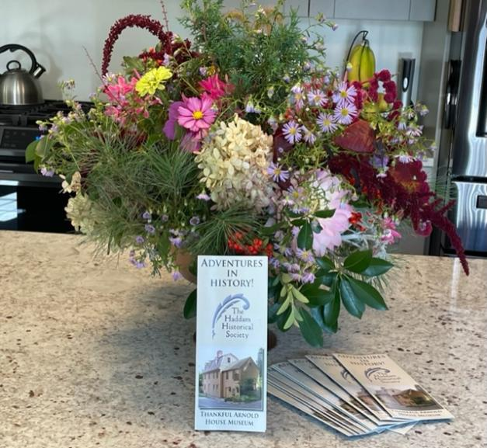

Slide 3
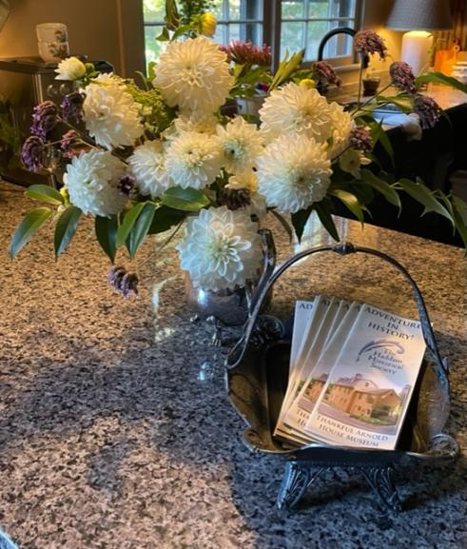

Slide 4
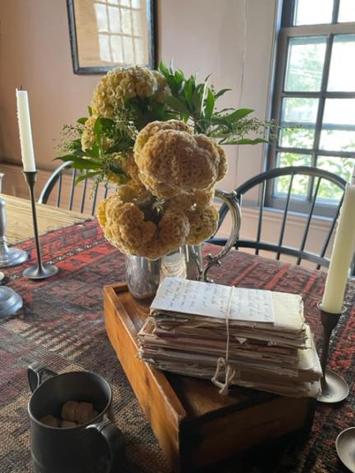

Slide 5
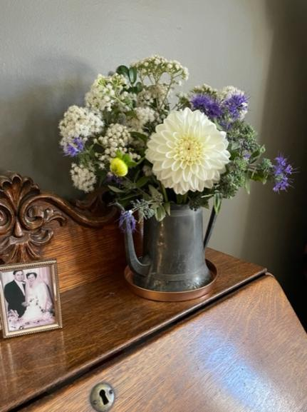

Slide 6
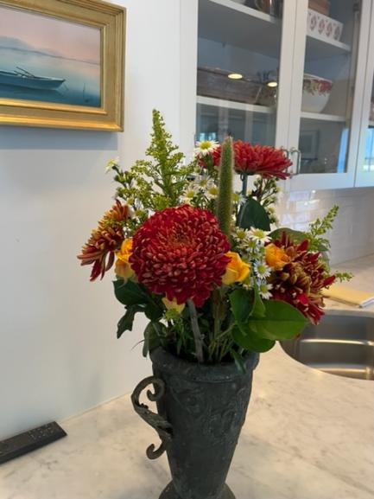

Slide 7
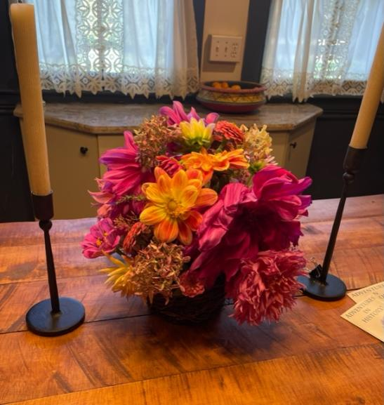

Slide 8
