Slide 1

Federal Garden Clubs of CT Awards Ceremony
Honoring Rogene Gillmor for Outstanding Service
with the Lillian M. Rathburn Award
and The Haddam Garden Club with a Certificate of Achievement for Managing the Flower and Horticulture Division of the Haddam Neck Fair
Aqua Turf Club, Plantsville, CT
October 22, 2025

Slide 2
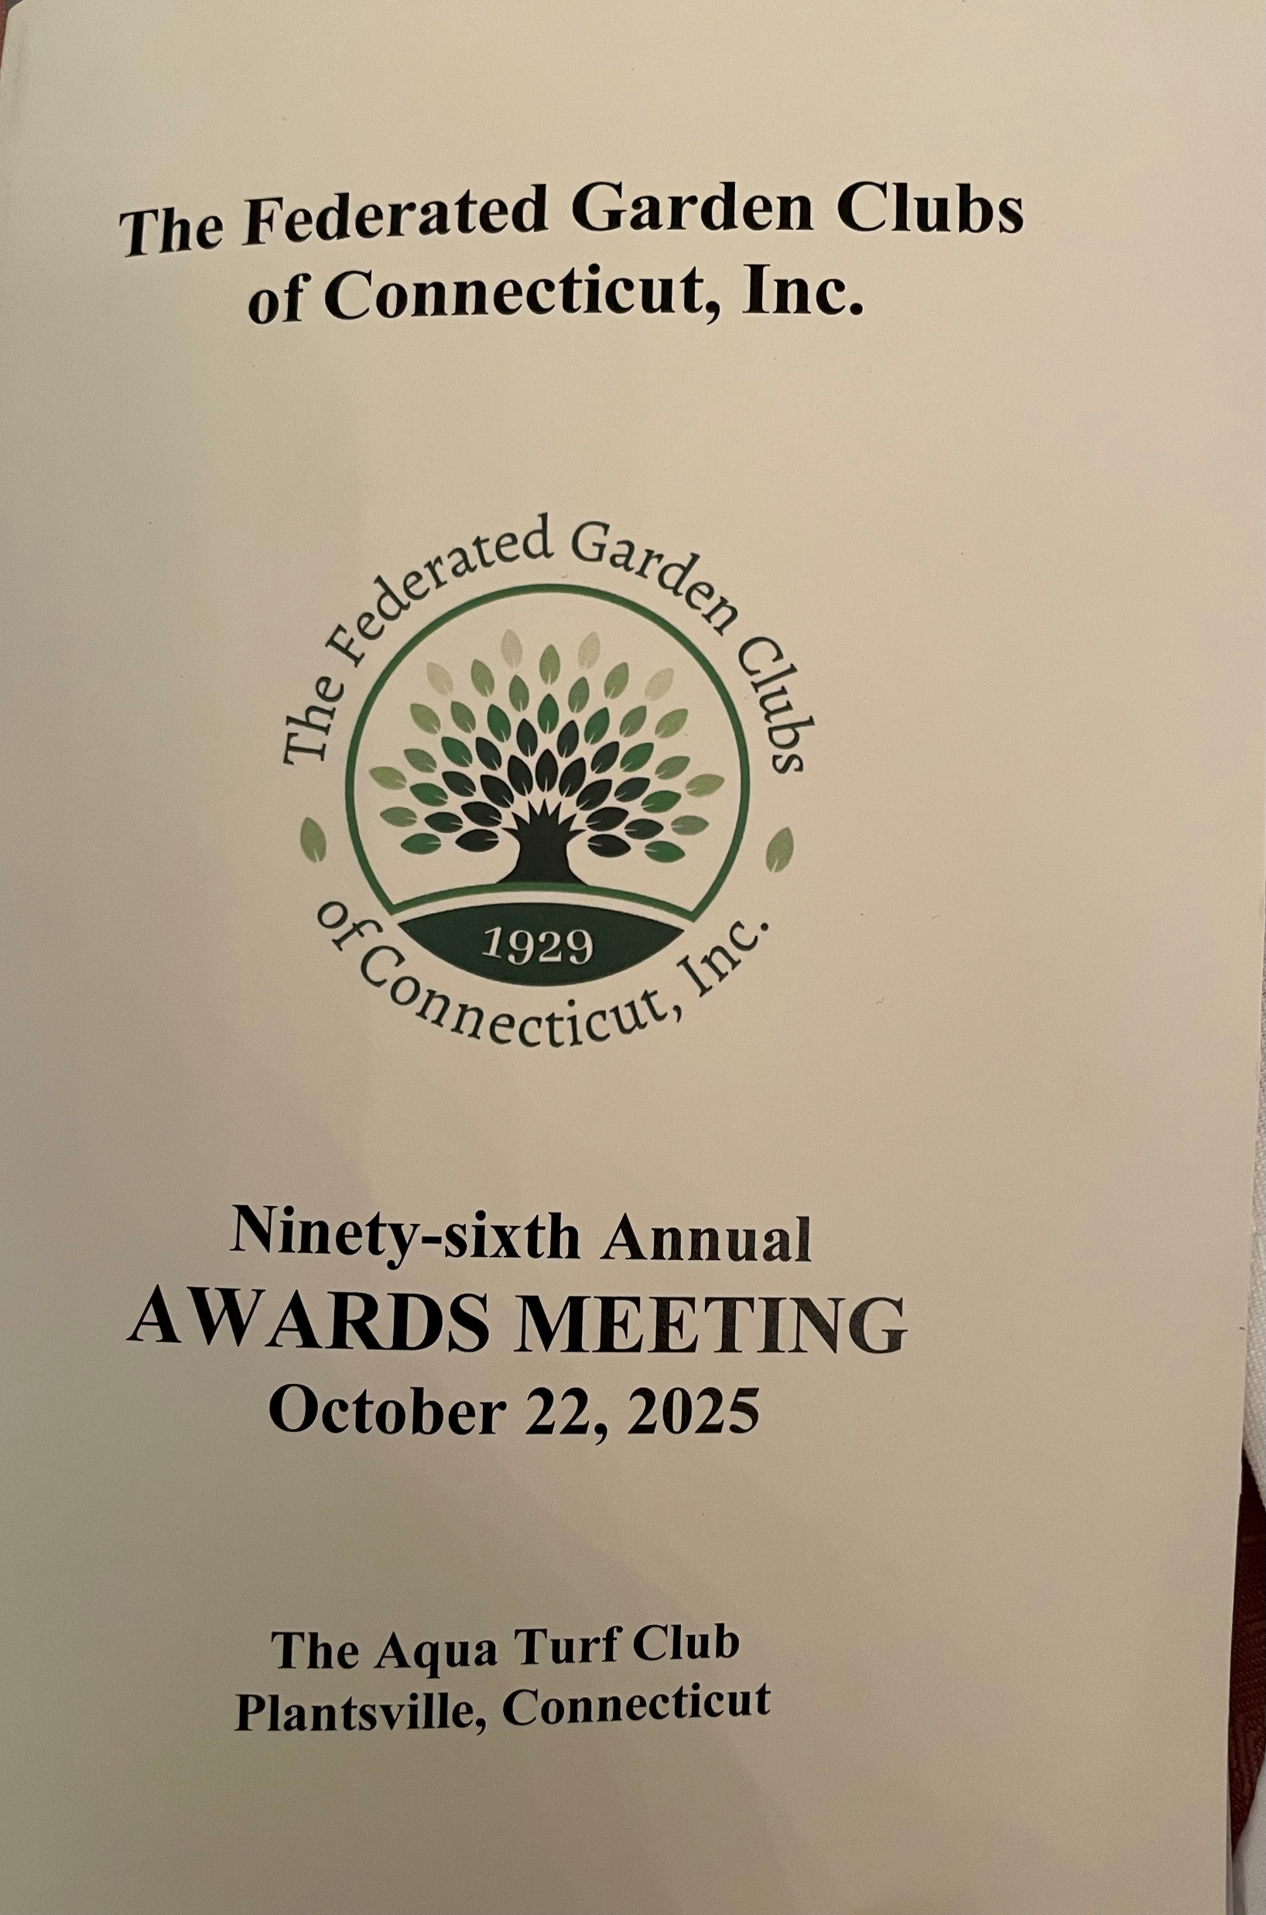

Slide 3
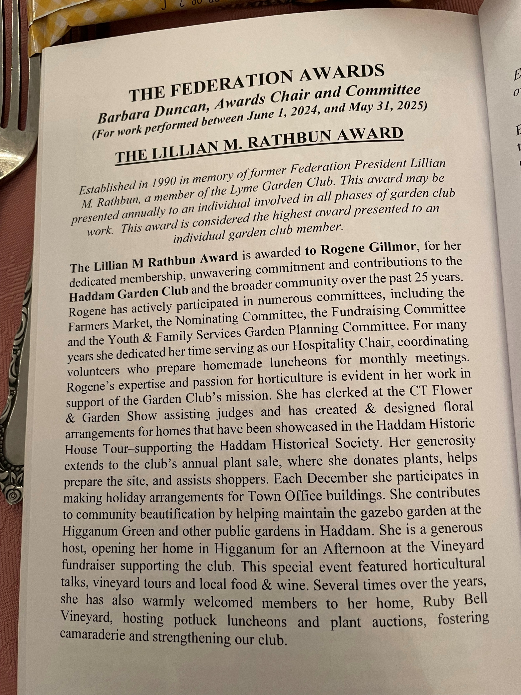

Slide 4
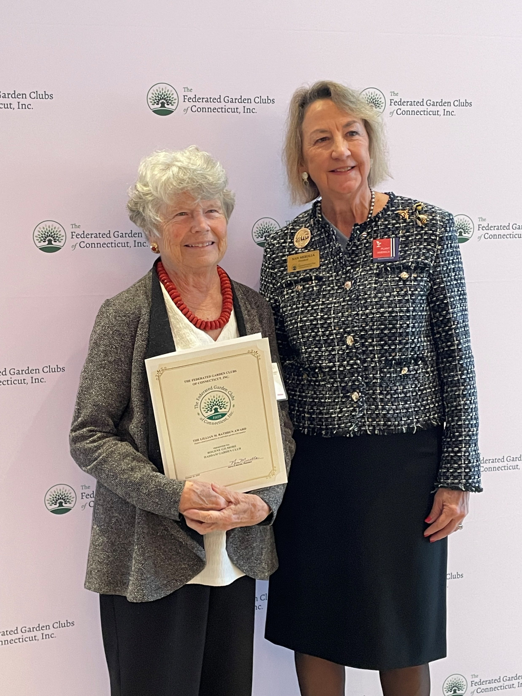

Slide 5
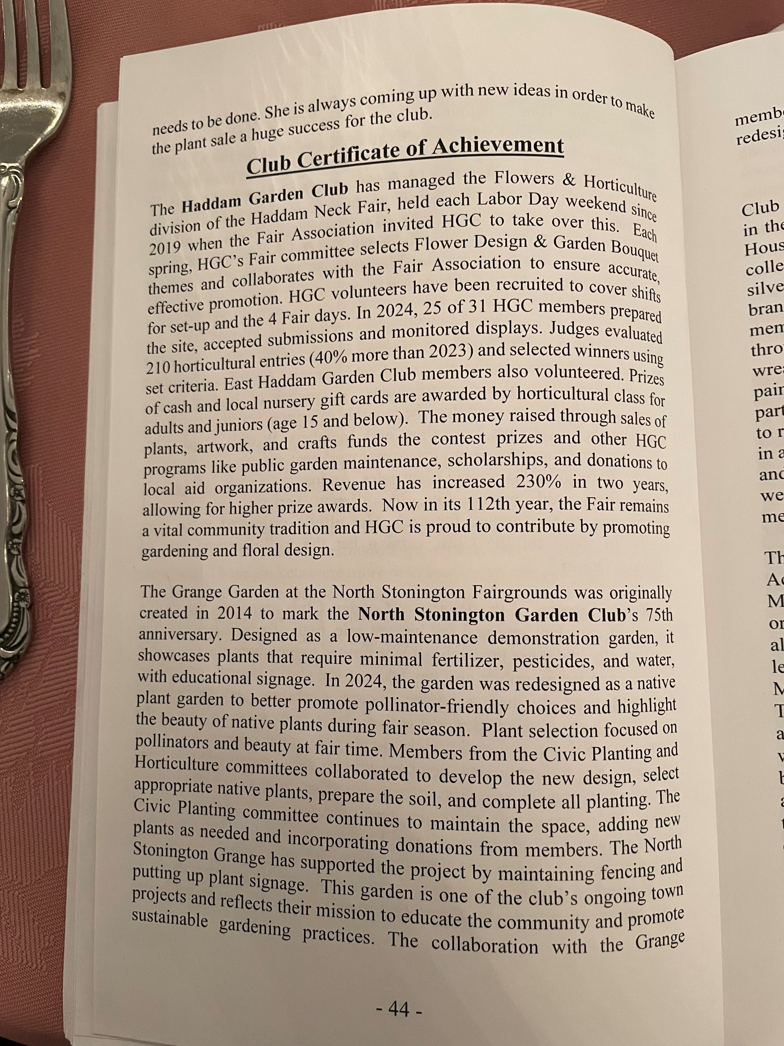

Slide 6
