Slide 1
Haddam Garden Club Welcome Sign Replacement Rt. 81 Connector, Haddam, CT September 27, 2021

Slide 2
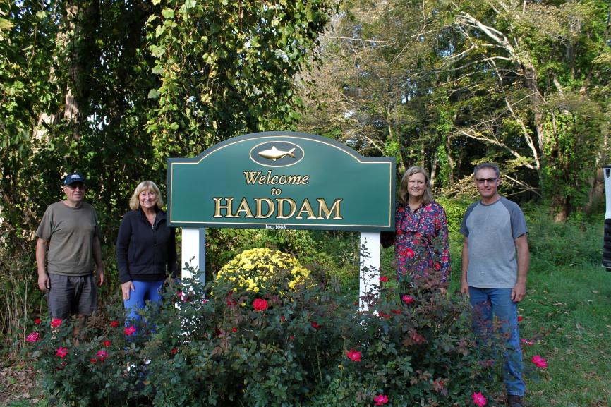

Slide 3
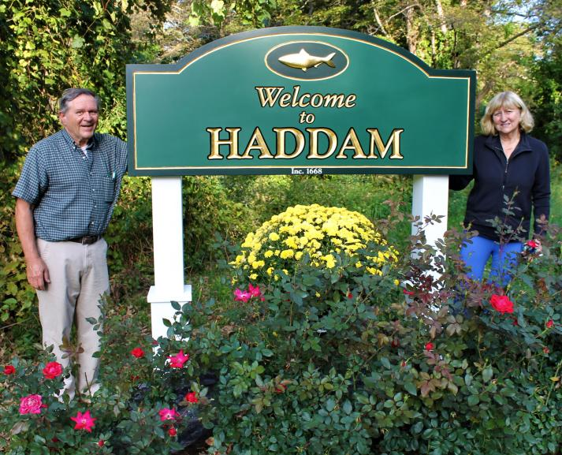

Slide 4
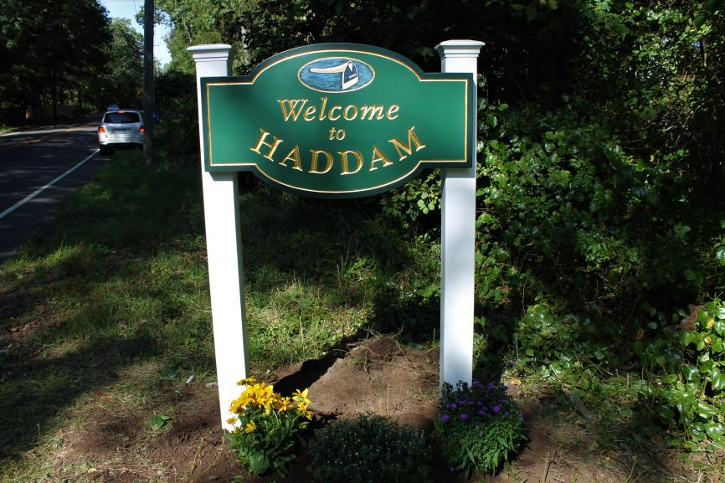

Slide 5
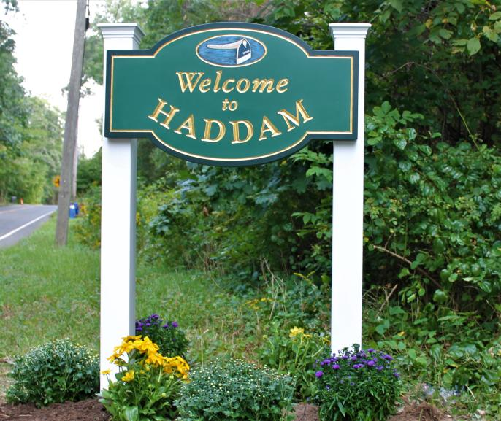

Slide 6
