Slide 1

Haddam Garden Club
“Putting Our Gardens to Bed”
Presentation by Nancy McKinnon of Ballek’s Garden Center
Haddam Community Center, Higganum, CT
October 12, 2022

Slide 2
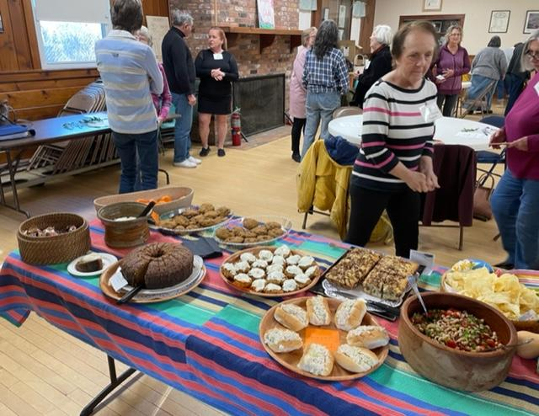

Slide 3
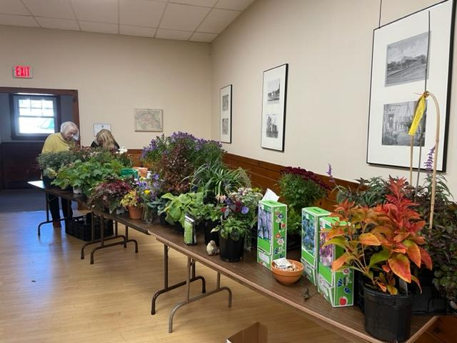

Slide 4
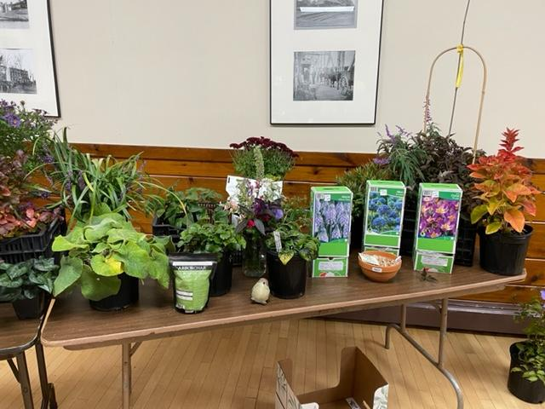

Slide 5
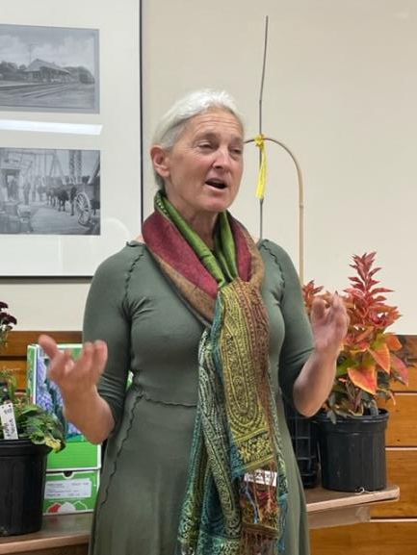

Slide 6
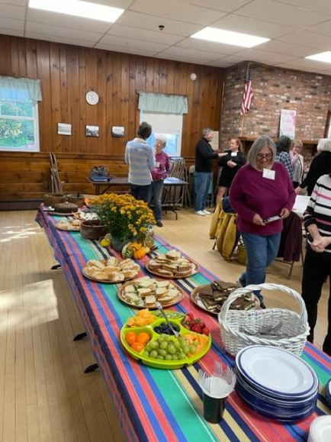

Slide 7
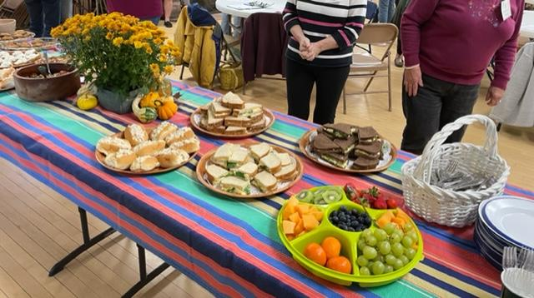

Slide 8
